Slide 1

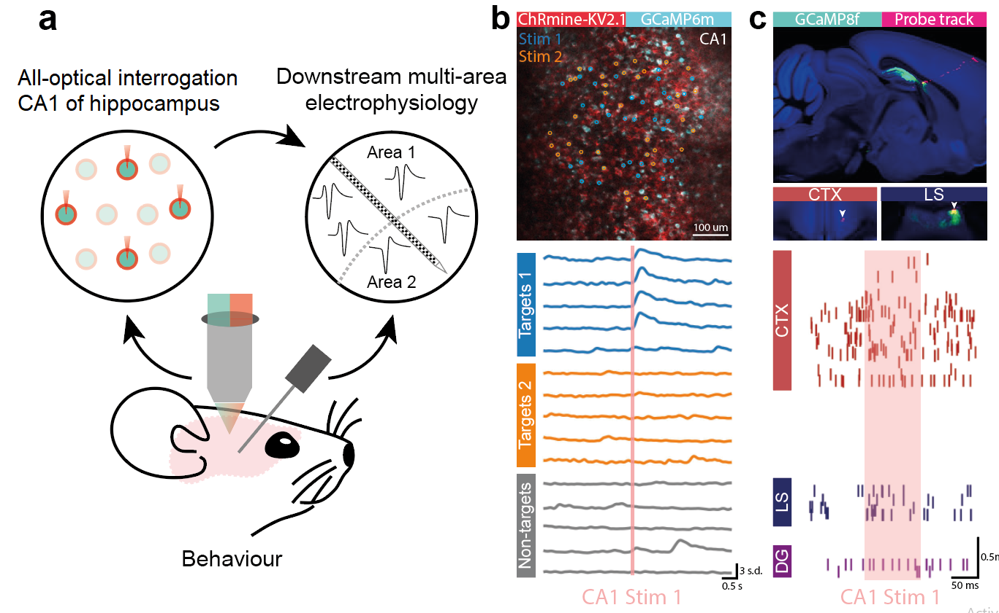
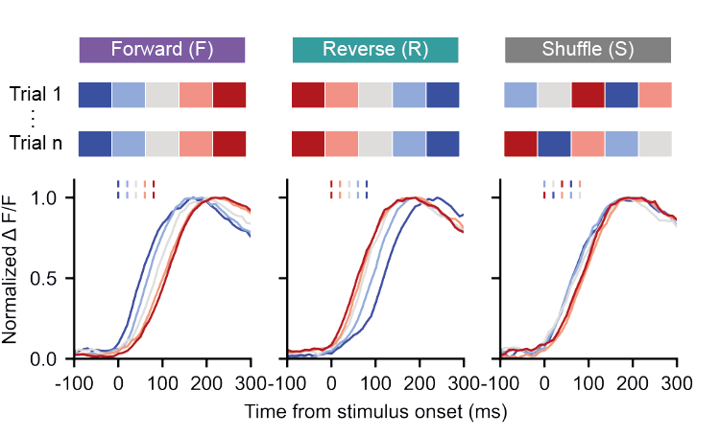
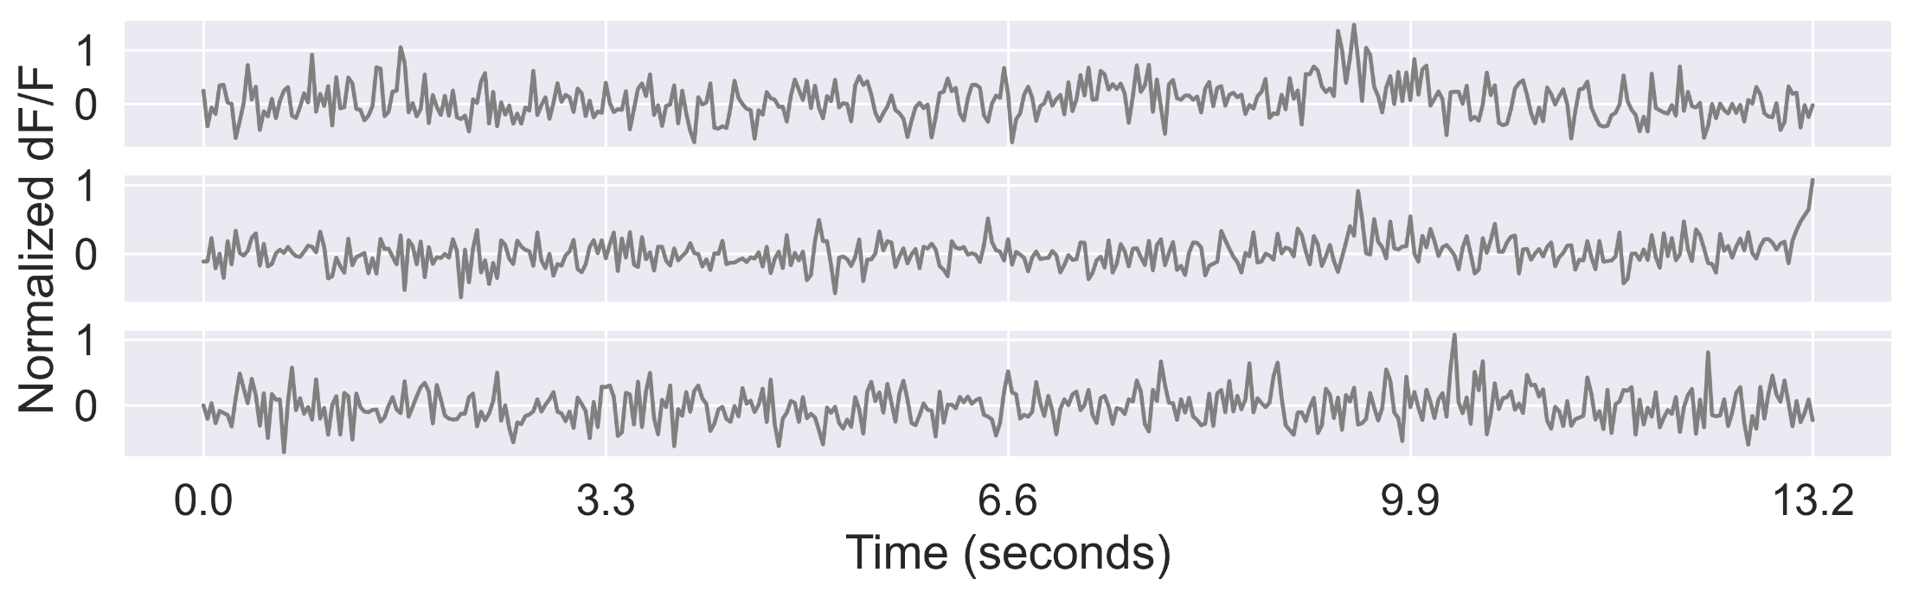
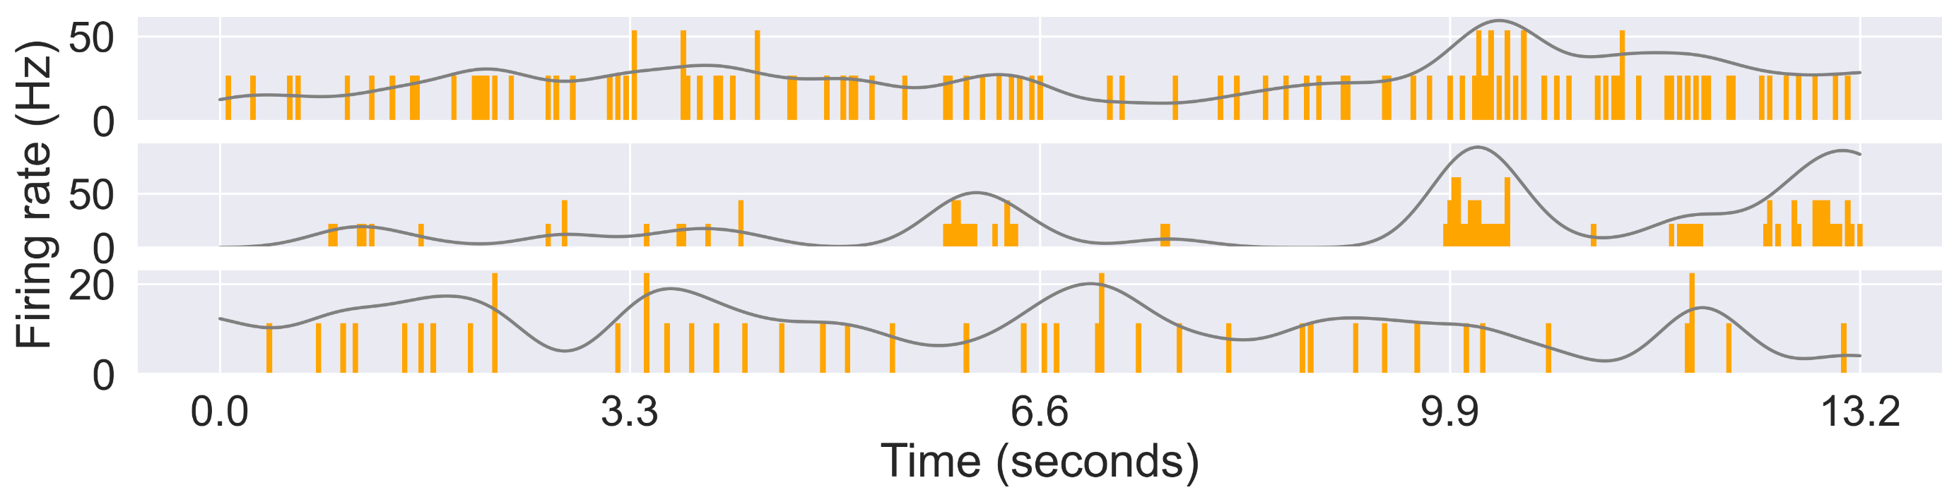
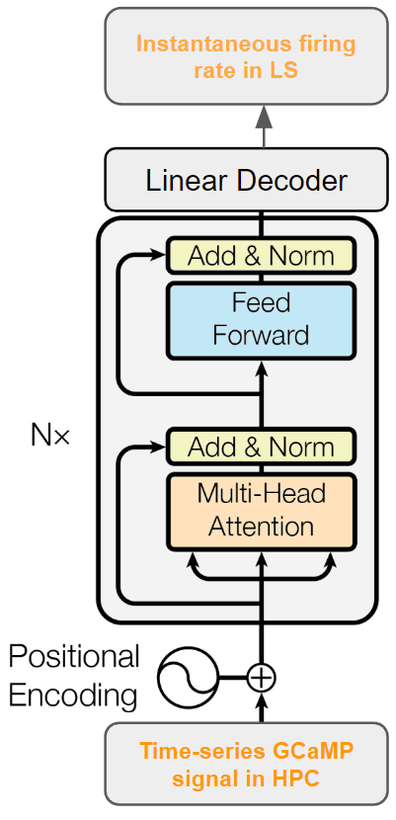
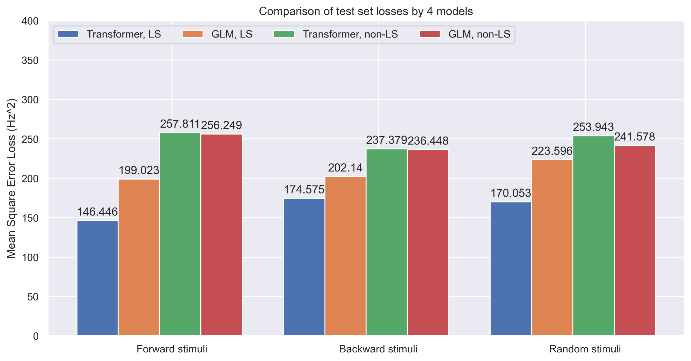
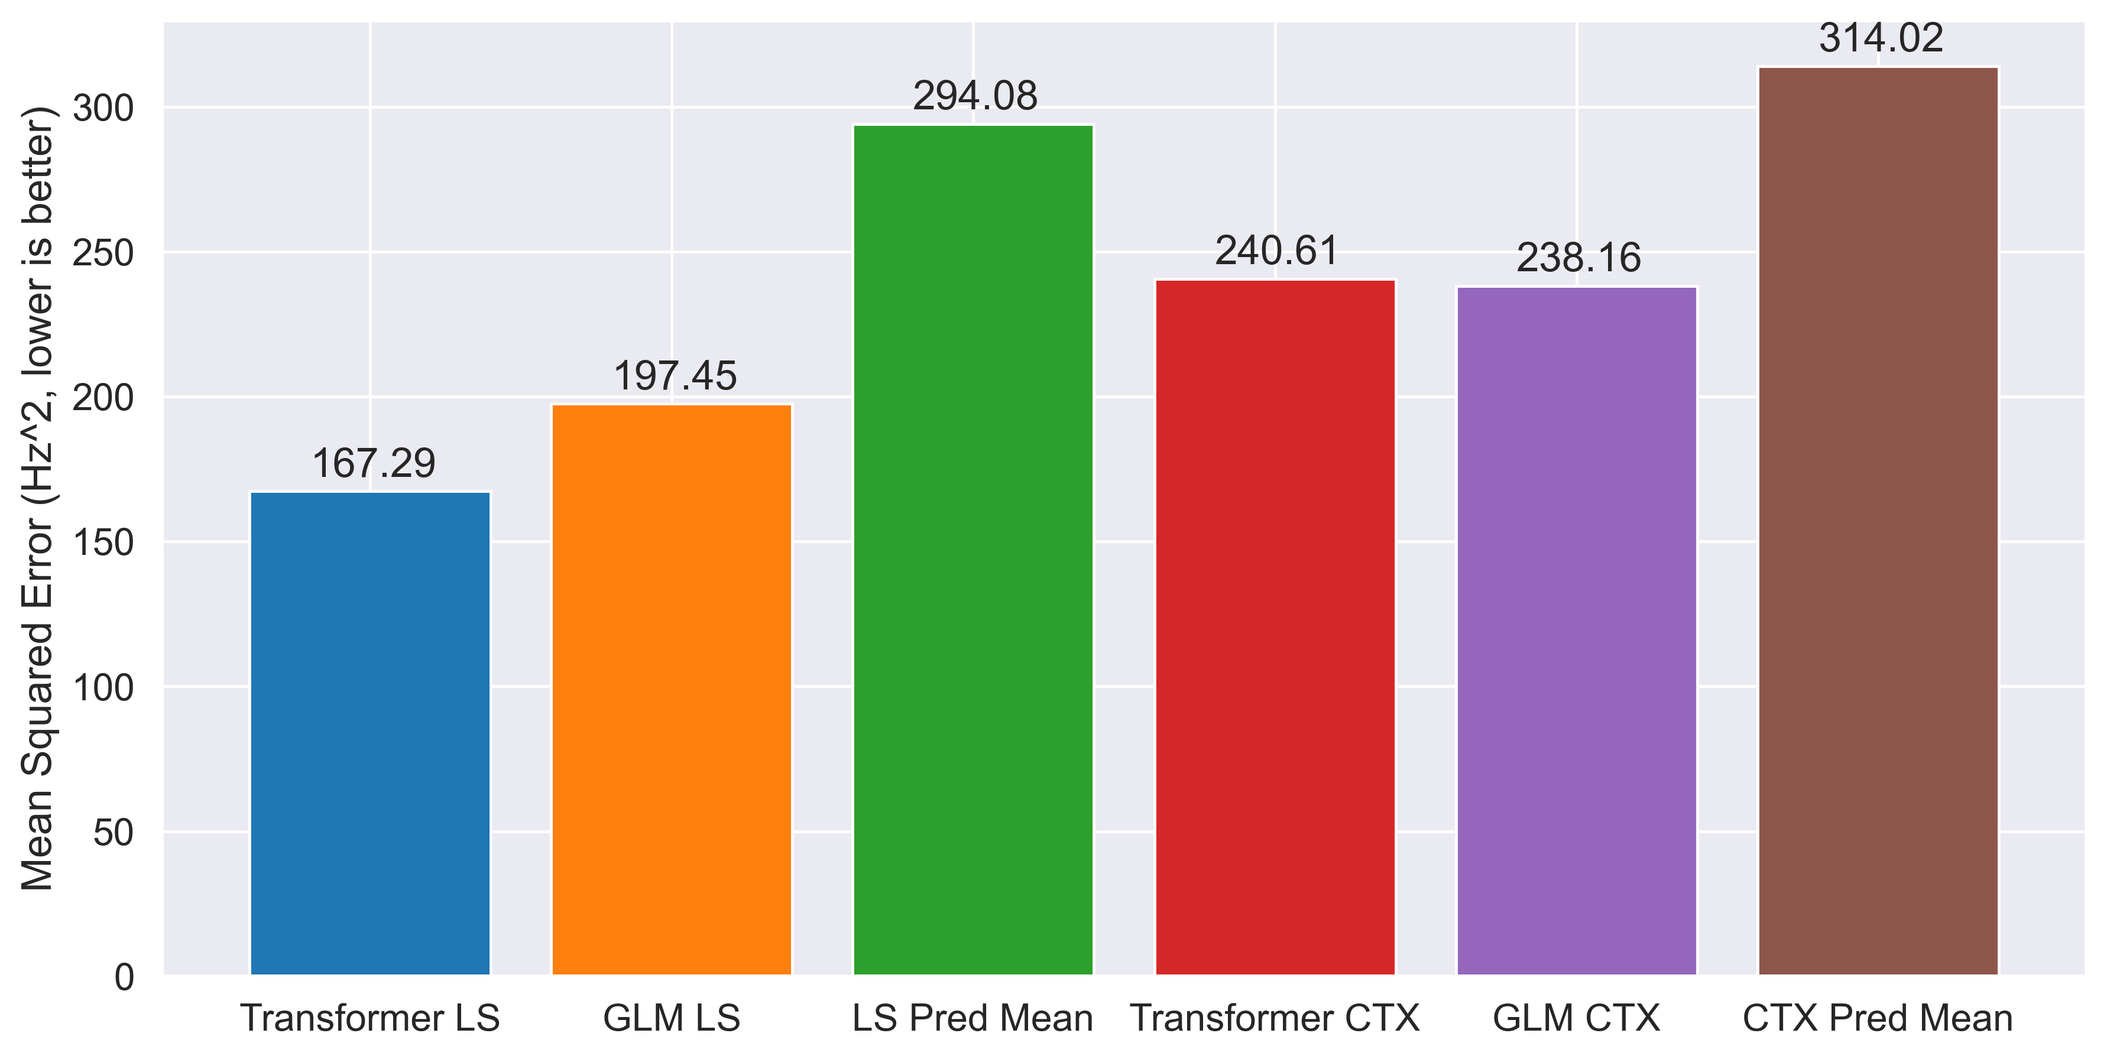
Transformer Learns Neural Circuit with Diverse Stimulation Patterns
S. Liu^{1*}; A. Mavor-Parker^{2,3*}; E. Baumler; M. Buchholz & C.Barry¹
¹ UCL Dept of Cell & Developmental Biology. ² UCL Inst yyy. ³ UCL Inst of xxx. * Equal contribution. Correspondence to first.author@ucl.ac.uk or caswell.barry@ucl.ac.uk
To understand the brain, we need to understand the computations performed by neural circuits. One approach is to use observed data to distil the neural function into artificial neural networks.
We simultaneously performed all-optical and Neuropixel recordings in two brain areas… We then trained Transformer neural networks on the data pairs.
Simultaneous neural recordings
Stimuli injection
GCaMP signals in hippocampus CA1
Multi-unit spiking activities in the lateral septum (LS) and neocortex, smoothened at 330 ms
CA1
HPC 7
HPC 126
HPC 268
CTX 15
CTX 67
LS 3
Transformer learns endogenous activities
Conclusions
¹Hafting et al (2005) Microstructure of a spatial map in the entorhinal cortex. Nature 436, 801-806. ²Fiete et al (2008) What Grid Cells Convey about Rat Location. J Neurosci 28, 6858-71. ²Kubie & Fenton (2012) Linear Look-ahead in Conjunctive Cells: An Entorhinal Mechanism for Vector-Based Navigation. Front. Neural Circuits doi: 10.3389. ⁴Orchard et al (2013) Does the entorhinal cortex use the Fourier transform? Front Comp Neurosci 7:179. ⁵Chen & Verguts (2010) Beyond the mental number line: A neural network model of number-space interactions. Cogn Psychol 60:218-240.

